Slide 1
Representing Information Digitally

Slide 2
Analog and Digital Information
Computers are finite!
How do we represent an infinite world?
We represent enough of the world to satisfy our computational needs and our senses of sight and sound

Slide 3
Analog and Digital Information
Information can be represented in one of two ways: analog or digital
  Analog data
  A continuous representation, analogous to the actual information it represents
  Digital data
  A discrete representation, breaking the information up into separate elements

Slide 4
Analog and Digital Information
Computers cannot work well with analog data, so we digitize the data
Digitize
Breaking data into pieces and representing those pieces separately

Slide 5
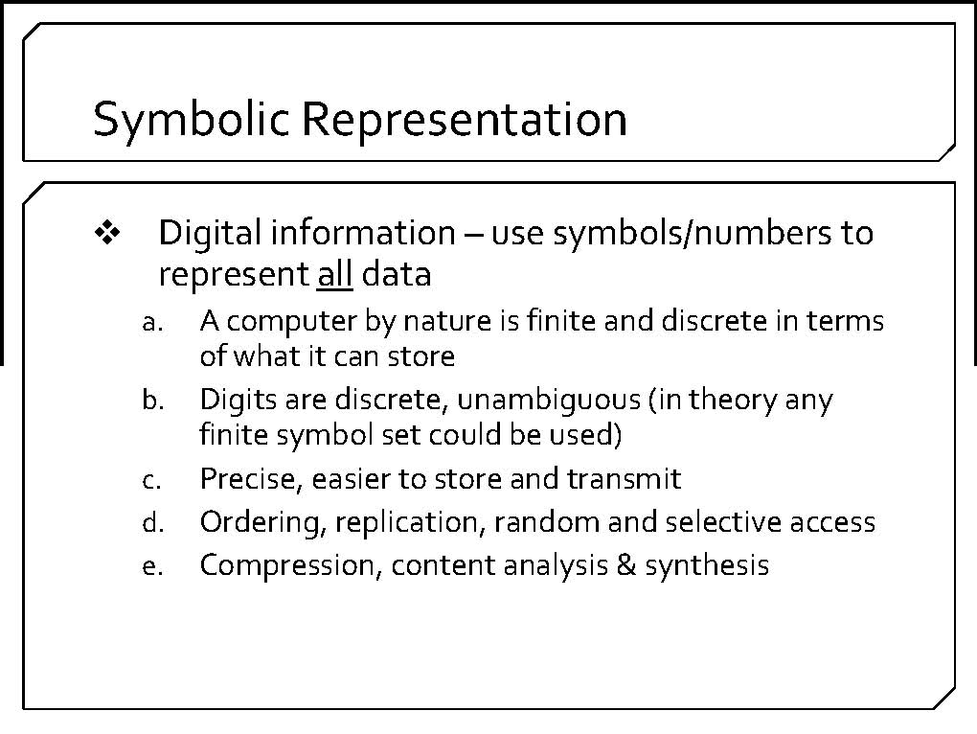
computers process discrete or digital data

Slide 6
Binary Representations
One bit can be either 0 or 1
One bit can represent two things (Why?)
Two bits can represent four things (Why?)
How many things can three bits represent?
How many things can four bits represent?
How many things can eight bits represent?
Why do we use binary to represent digitized data?

Slide 7
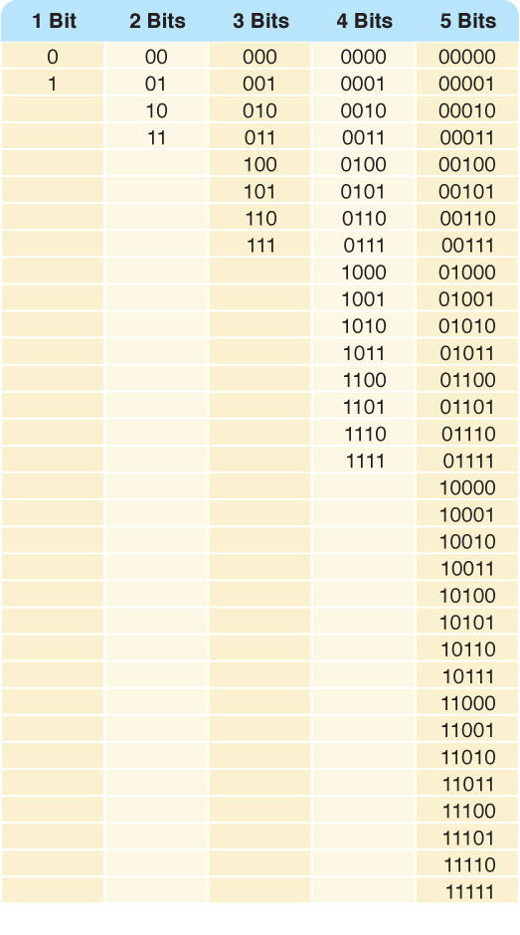
Binary Representations
Counting with
binary bits
2^{n}
Figure 3.4

Slide 8
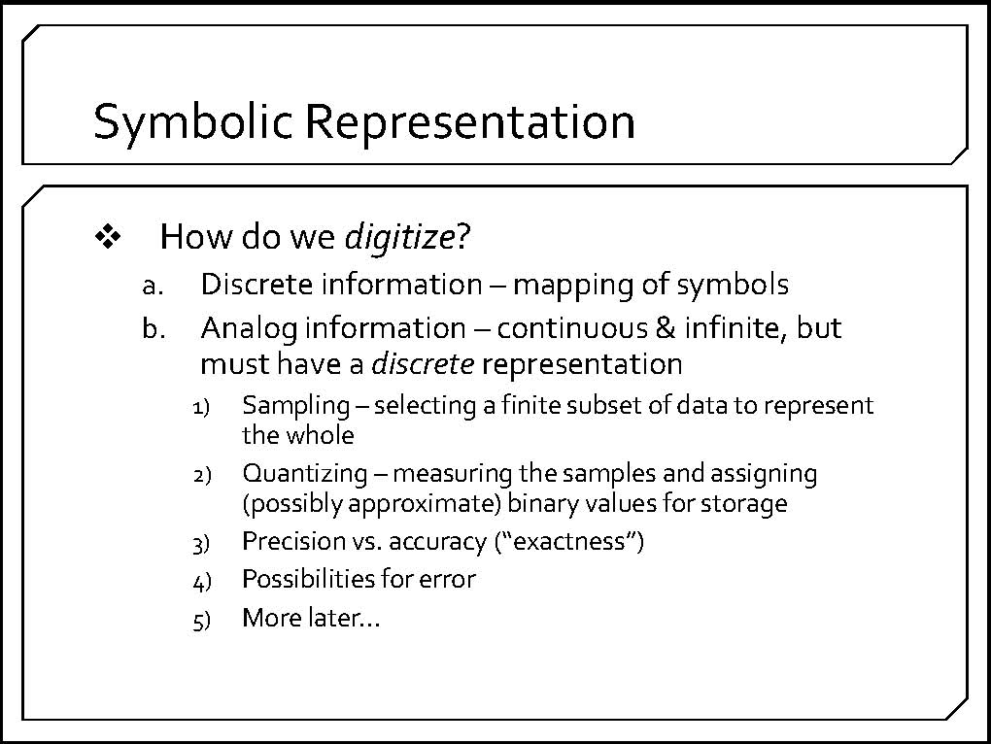
the process of converting information to a binary form is called digitization
both discrete and analog forms of information may be digitized

Slide 9
Numbers

Slide 10
Storing Numbers
Bit represents two values, 0 and 1
Computers use binary numbering system
  Position of digit j is assigned the value 2^{j-1}
  To determine value of binary number sum position values of the 1s
Byte size limits are 0 and 255
  0 = all bits off; 255 = all bits on
  To store larger number, use several bytes

Slide 11
Base 10 Number System
Organized plan for representing a number
  Base 10 or decimal notation
  Uses 10 digits (0–9)
  System used to represent all of the numeric values we use each day
10³ 1,000s place | 10² 100s place | 10¹ 10s place | 10⁰ 1s place
6 * 1,000 + | 9 * 100 + | 5 * 10 + | 4 * 1
(6,000 + 900 +
50 + 4) = 6,954
Notes:
The base 10 number system, also known as decimal notation, is the system used to represent all of the numeric values you use each day. It’s called base 10 because it uses 10 digits, 0 through 9, to represent any value.
In the base 10 number system, a whole number is represented as the sum of ones, tens, hundreds, and thousands—sums of powers of 10.

Slide 12
Numbers in binary
Place value system just like decimal
  We understand 278 = (2 * 100) + (7 * 10) + (8 * 1)
In a binary number:
  Each digit is either a 0 or 1
  Digits are multiplied by powers of 2, not powers of 10.
Computers use binary because each switch can be in one of two positions: on or off.
For example, 001110 and 100011:
2³ 8s place | 2² 4s place | 2¹ 2s place | 2⁰ 1s place
1 | 0 | 1 | 1
(8 + 0 + 2 + 1) = 11
Notes:
Try some examples.

Slide 13
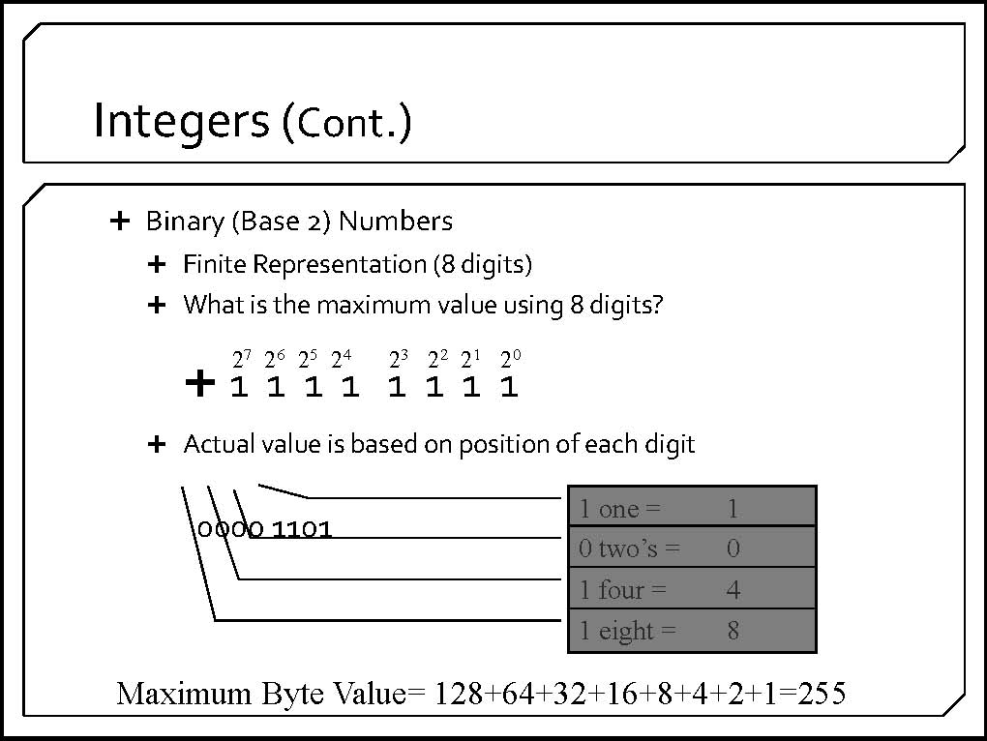

Slide 14
Converting Binary to Decimal
What is the decimal equivalent of the binary number 1101110?
1 x 2⁶ = 1 x 64 = 64
+ 1 x 2⁵ = 1 x 32 = 32
+ 0 x 2⁴ = 0 x 16 = 0
+ 1 x 2³ = 1 x 8 = 8
+ 1 x 2² = 1 x 4 = 4
+ 1 x 2¹ = 1 x 2 = 2
+ 0 x 2º = 0 x 1 = 0
= 110 in base 10
13

Slide 15
You would need five bits. Four bits can represent 16 things, which would not be sufficient, while five bits can represent up to 32 things.

Slide 16
Decimal → binary
One thing to note is that binary numbers are “longer” than decimal.
  A 5-digit decimal number may turn out to be 15 bits long.
My technique is the “binary store”
  All merchandise is priced $1, $2, $4, $8, $16, …
  You enter store with some money, say $45.
  Goal is to always buy most expensive gift possible.
  So, 45 = 32 + 8 + 4 + 1
32 * | 16 * | 8 * | 4 * | 2 * | 1 *
1 | 0 | 1 | 1 | 0 | 1

Slide 17
Another example
Convert 61 to binary:
Go to binary store with $61…
61 = 32 + 16 + 8 + 4 + 1
Another way to write this is:
61 = 2⁵ + 2⁴ + 2³ + 2² + 2⁰
Our binary answer is 111101.

Slide 18
Decimal 14 Converted to Binary
2⁸ | 2⁷ | 2⁶ | 2⁵ | 2⁴ | 2³ | 2² | 2¹ | 2⁰
256 | 128 | 64 | 32 | 16 | 8 | 4 | 2 | 1
0 | 0 | 0 | 0 | 0 | 1 | 1 | 1 | 0
Decimal 176 Converted to Binary
176
-128
48
-32
16
-16
2⁸ | 2⁷ | 2⁶ | 2⁵ | 2⁴ | 2³ | 2² | 2¹ | 2⁰
256 | 128 | 64 | 32 | 16 | 8 | 4 | 2 | 1
0 | 1 | 0 | 1 | 1 | 0 | 0 | 0 | 0

Slide 19
Advanced Number Storage
To store negative numbers and real numbers, computers use binary numbering and encoding schemes
  Negative numbers encoded using two’s complement
  Real numbers encoded using floating-point notation

Slide 20
Risks in Numerical Computing
Almost all computer calculations involve roundoff error (limited precision error)
If not monitored and planned for carefully, such errors can lead to unexpected and catastrophic results
  Ariane 5 Rocket Failure
  Patriot Missile Failure during Gulf War

Slide 21
The Explosion of the Ariane 5
On June 4, 1996 an unmanned Ariane 5 rocket launched by the European Space Agency exploded just forty seconds after its lift-off.
The rocket was on its first voyage, after a decade of development costing $7 billion. The destroyed rocket and its cargo were valued at $500 million.
It turned out that the cause of the failure was a software error in the inertial reference system. Specifically a 64 bit floating point number relating to the horizontal velocity of the rocket with respect to the platform was converted to a 16 bit signed integer. The number was larger than 32,767, the largest integer storeable in a 16 bit signed integer, and thus the conversion failed.
Back

Slide 22
  Patriot Missile Failure during Gulf War
During the Gulf War, an American Patriot Missile battery in Saudi Arabia, failed to track and intercept an incoming Iraqi Scud missile. The Scud struck an American Army barracks, killing 28 soldiers and injuring around 100 other people.
The General Accounting office reported on the cause of the failure. It turns out that the cause was an inaccurate calculation due to computer arithmetic errors.
The time in tenths of second as measured by the system's internal clock was multiplied by 1/10 to produce the time in seconds.
The value 1/10, which has a non-terminating binary expansion, was chopped at 24 bits. The small chopping error, when multiplied by the large number giving the time in tenths of a second, led to a significant error. Indeed, the Patriot battery had been up around 100 hours, and an easy calculation shows that the resulting time error due to the magnified chopping error was about 0.34 seconds. (The number 1/10 equals 1/2⁴+1/2⁵+1/2⁸+1/2⁹+1/2¹²+1/2¹³+....
A Scud travels at about 1,676 meters per second, and so travels more than half a kilometer in this time. This was far enough that the incoming Scud was outside the "range gate" that the Patriot tracked.
Back

Slide 23
Text

Slide 24
Digital Representation - Text
Text
  letters
  punctuation
  invisible formatting characters

Slide 25
Text - One Byte per Character Suffices
Notes:
4

Slide 26
ASCII and the English Character Set
ASCII = American Standard Code for Information Interchange . Allows for 256 unique characters
Pronounced “As-key”
All uppercase and lowercase letters
Punctuation symbols like ! . , ? : ; “ ‘ etc.
Digits 0, …, 9
Arithmetic symbols + = - / < >
Assorted special symbols like # @ $ % ^ & * ( ) { } [ ] etc.
Invisible formatting characters
Notes:
5

Slide 27
ASCII
Represents each letter or character as an 8-bit (or 1-byte) binary code.
ASCII Code | Represents This Symbol | ASCII Code | Represents This Symbol
01000001 | A | 01100001 | a
01000010 | B | 01100010 | b
01000011 | C | 01100011 | c
01011010 | Z | 00100011 | #
00100001 | ! | 00100100 | $
00100010 | “ | 00100101 | %
Notes:
Most of today’s personal computers use the American National Standards Institute (ANSI, pronounced “An-see”) standard code, called the American Standard Code for Information Interchange (ASCII, pronounced “As-key”), to represent each letter or character as an 8-bit (or 1-byte) binary code.
The ASCII code represents the 26 uppercase letters and 26 lowercase letters used in the English language, along with many punctuation symbols and other special characters, using 8 bits.

Slide 28
Using ASCII
Notes:
6

Slide 29
Unicode
ASCII not enough characters for international use
Unicode – represent every character in every language including Asian ideograms
Uses 16 bits per character
Can represent 2¹⁶ or more than 65,000 characters compared to 256 for ASCII
Gaining in popularity

Slide 30
Sound

Slide 31
Representing Audio Information
A stereo sends an electrical signal to a speaker to produce sound
This signal is an analog representation of the sound wave
The voltage in the signal varies in direct proportion to the sound wave

Slide 32
Representing Audio Information
Digitize the signal by sampling
  periodically measure the voltage
  each sample is converted to a binary number
We periodically measure the voltage of the signal and record the appropriate numeric value, resulting in a series of numbers that represents the signal discretely.
How often should we sample?
A sampling rate of about 40,000 times per second is enough to create a reasonable sound reproduction

Slide 33
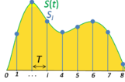
Representing Audio Information
Some data
is lost, but a
reasonable
sound is
reproduced
Figure 3.8 Sampling an audio signal

Slide 34
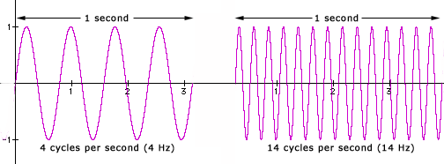
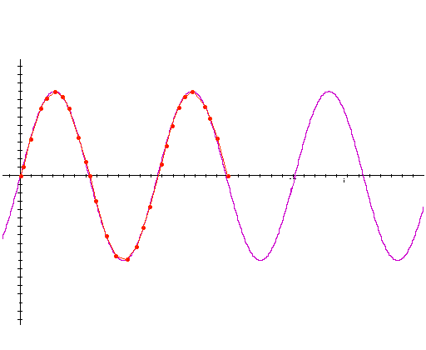
Nyquist's Sampling Theorem
The number of cycles per unit of time is called the frequency.
Frequency is most often measured in cycles per second (cps) or Hertz
Nyquist rate -- For lossless digitization, the sampling rate should be
  at least twice the maximum frequency responses. Indeed many times more the better.

Slide 35
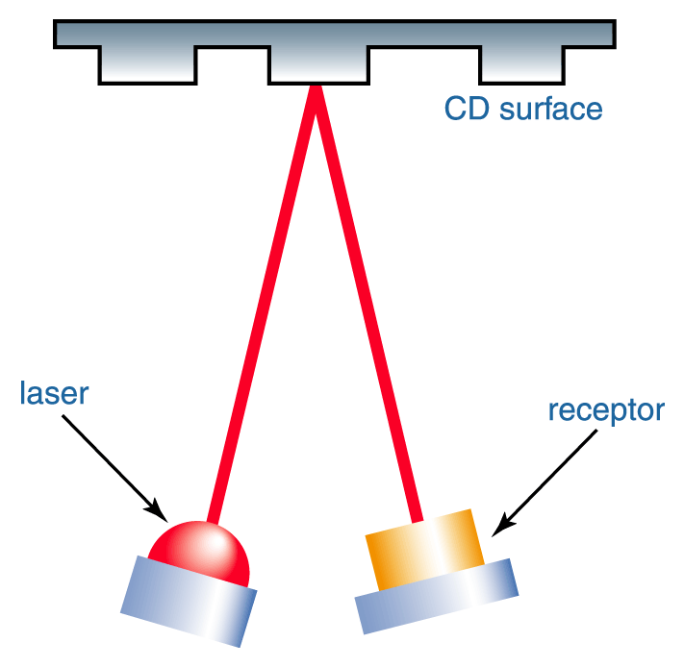
Representing Audio Information
CDs store audio information digitally
On the surface of the CD are microscopic pits that represent binary digits
A low intensity laser is pointed as the disc The laser light reflects strongly if the surface is smooth and poorly if the surface is pitted
How do vinyl record albums and compact discs differ in the way they represent sound?
The groove in a vinyl record album is an analog representation of the sound, whereas, compact discs store binary numeric values that approximate the sound wave.

Slide 36
Images

Slide 37
Digital images are composed of pixels
  To store images, each pixel is converted to a binary number representing the pixel’s color

Slide 38
Representing Images and Graphics
Color
Perception of the frequencies of light that reach the retinas of our eyes
Retinas have three types of color photoreceptor cone cells that correspond to the colors of red, green, and blue

Slide 39
Representing Images and Graphics
Color is expressed as an RGB (red-green-blue) value--three numbers that indicate the relative contribution of each of these three primary colors
An RGB value of (255, 255, 0) maximizes the contribution of red and green, and minimizes the contribution of blue, which results in a bright yellow

Slide 40
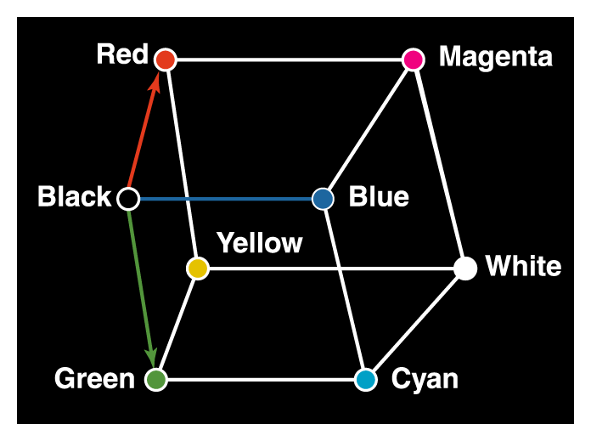
Representing Images and Graphics
Figure 3.10 Three-dimensional color space

Slide 41
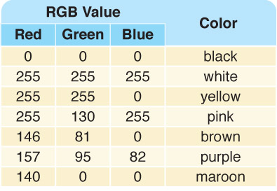
Representing Images and Graphics
A few TrueColor
RGB values and
the colors they
represent

Slide 42
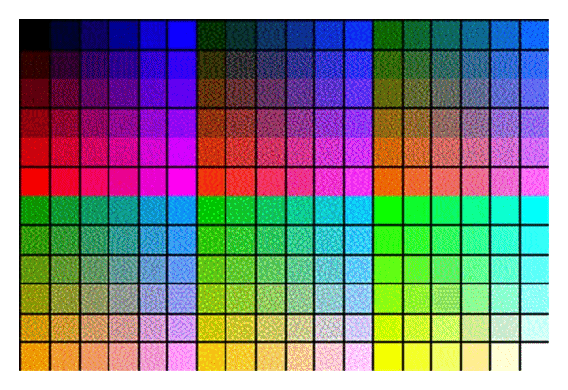
Indexed Color
A browser may support only a certain number of specific colors, creating a palette from which to choose
Figure 3.11
A restricted color palette.

Slide 43
Digitized Images and Graphics
Digitizing a picture
Representing it as a collection of individual dots called pixels
Resolution
The number of pixels used to represent a picture
The higher the resolution, the more realistic the picture looks when presented.
Raster (also called Bitmapped) Graphics
Storage of data on a pixel-by-pixel basis
Bitmap (BMP), GIF, JPEG, and PNG are raster-grahics formats
Photographs are raster

Slide 44
Digitized Images and Graphics
Bitmap format
Contains the pixel color values of the image from left to right and from top to bottom
GIF format (indexed color) well-suited for simpler images such as graphics or logos with solid areas of color
Each image is made up of only 256 colors
JPEG format JPEG format stores averages out of the color hues over short distances.
This format is superior for photographic color images
Averages color hues over short distances
PNG format
Like GIF but achieves greater compression with wider range of color depths
Which is better for animated images on the Web? Photos?

Slide 45
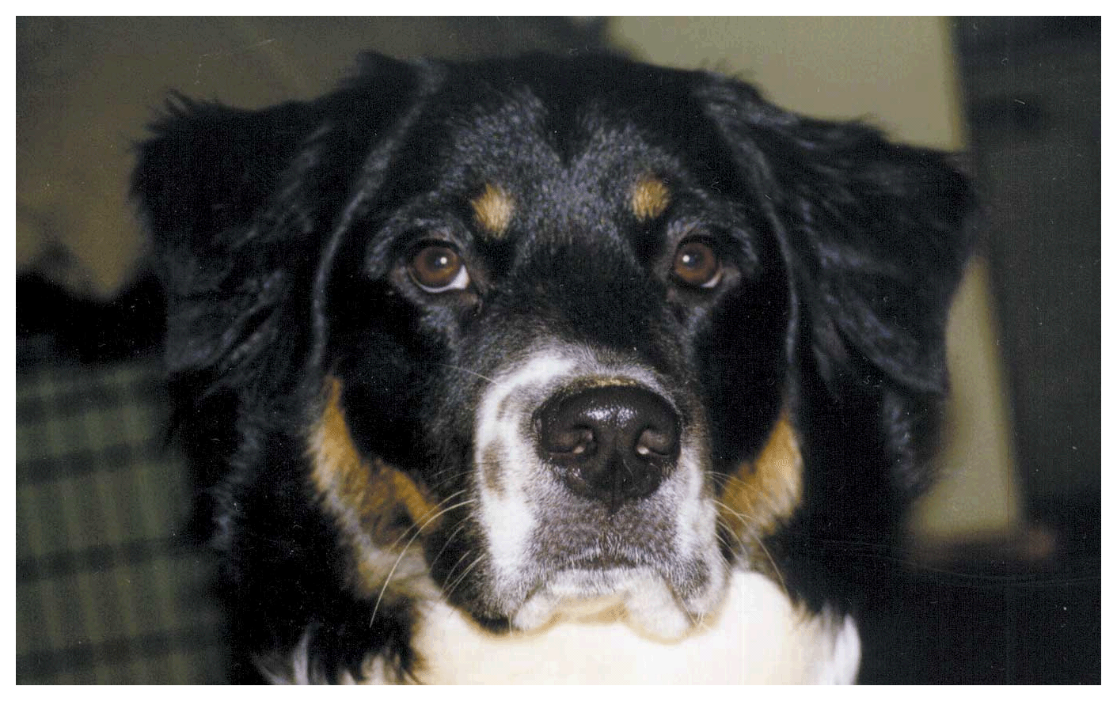
Digitized Images and Graphics
Whole
picture
Figure 3.12 A digitized picture composed of many individual pixels

Slide 46
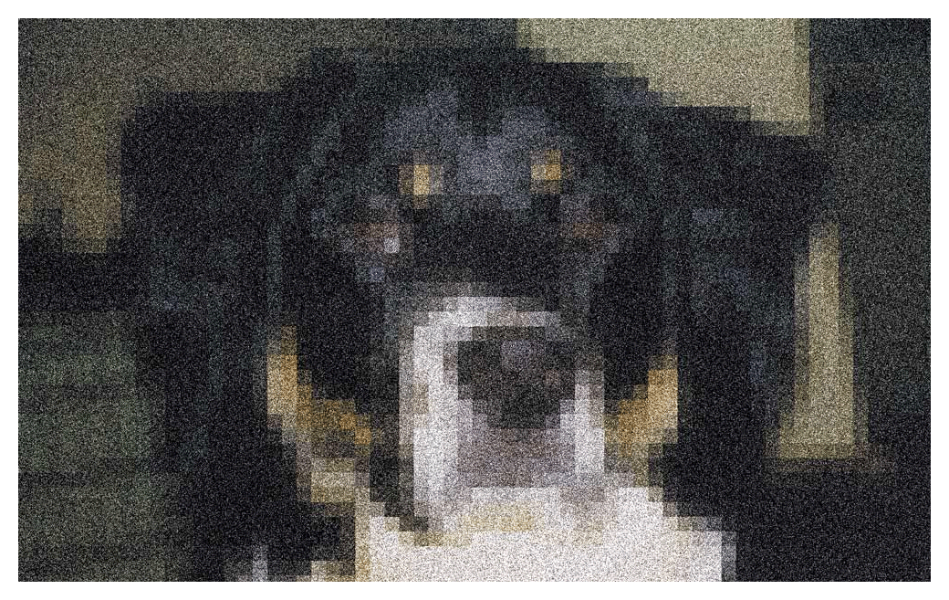
Digitized Images and Graphics
Magnified portion
of the picture
See the pixels?
Figure 3.12 A digitized picture composed of many individual pixels

Slide 47
Example: Digitizing Images
The two step process for digitizing images:
  sampling the continuous tone image for pixels
  quantizing pixels
image is sampled by pixel resolution
pixels samples are averaged

Slide 48
Example: Digitizing Images
pixels are converted to numeric form
The two step process for digitizing images:
  sampling the continuous tone image for pixels
  quantizing pixels

Slide 49
Vector Graphics
Vector graphics
A format that describes an image in terms of lines and geometric shapes
A vector graphic is a series of commands that describe a line’s direction, thickness, and color.
The file sizes tend to be smaller because not every pixel is described.

Slide 50
Vector Graphics
The good side and the bad side…
Vector graphics can be resized mathematically and changes can be calculated dynamically as needed.
Vector graphics are not good for representing real-world images.

